Slide 1
Business Proposal: Liquor Store in Iowa

Slide 2
Project Overview
The purpose of this project was to make a business case for a liquor store in Iowa. I went through several key pieces of information that any potential business owner or entrepreneur would need to know.
What city should a new store be placed in?
What are key vendor relationships?
Which products have the highest sales and are growing over the past 3 years?
Which products should be on the shelves?

Slide 3
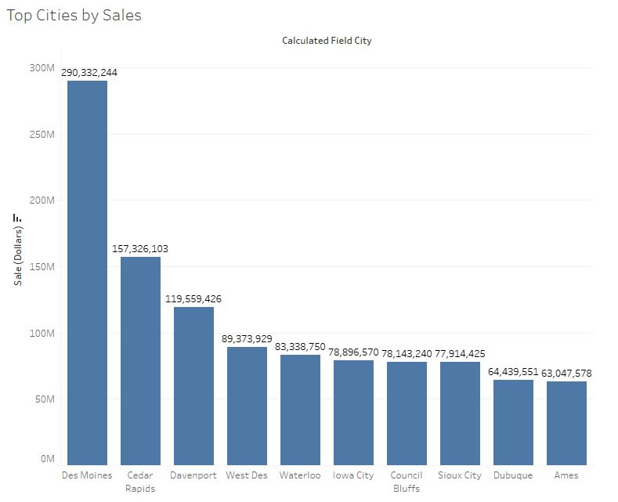
Total Sales by City
The first thing to look at was liquor sales by city in Iowa. Des Moines has clearly the highest sales followed by Cedar Rapids and Davenport.

Slide 4
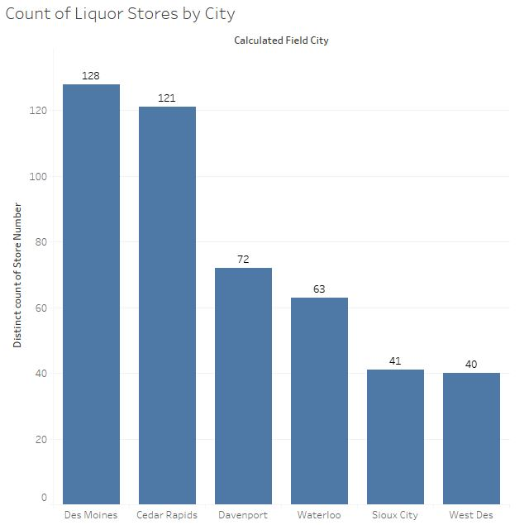
Total Stores By City
However, Cedar Rapids has almost as many stores as Des Moines despite being half of their sales. A similar issue arises for Davenport. Davenport has 59% the amount of stores as a Cedar Rapids despite only having 25% less in sales.

Slide 5
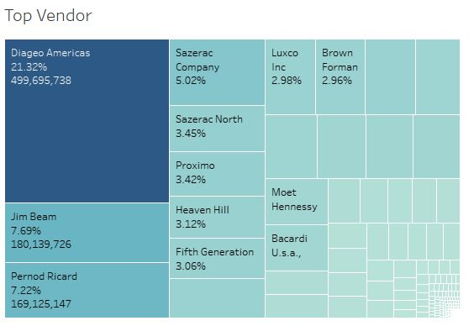
Vendor Breakdown
Vendor relationships are vitally important in the liquor industry and rely heavily on trust and communication (Wachira). With that in mind this visual makes it clear that Diageo Americas should be a top priority to have a relationship with.

Slide 6
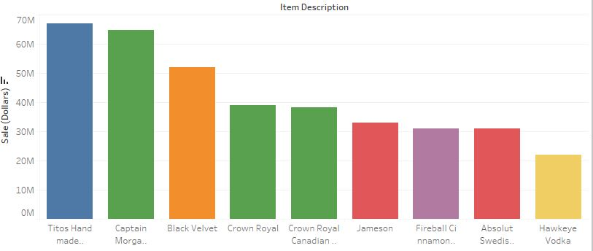
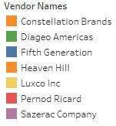
Vendor Breakdown By Product
The evidence of a needed relationship with Diageo Americas is made even more clear by the company supplying three of the top five bottles sold in Iowa.

Slide 7
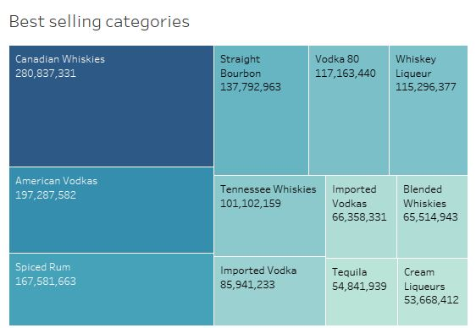
Best Selling Categories
The top 12 categories are dominated by different kinds of Vodkas and Whiskies. The only outliers being Spiced Rum, Tequila, Bourbon and Cream Liqueurs.

Slide 8
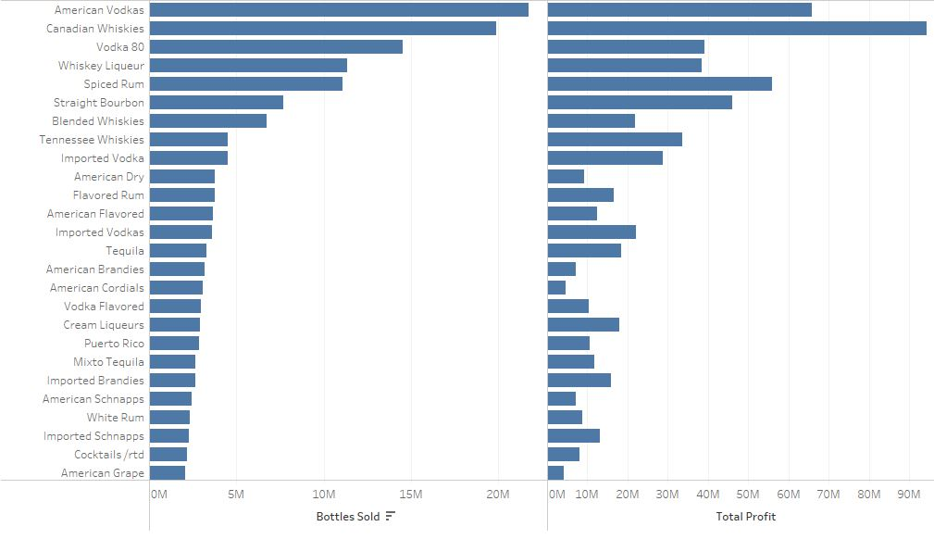
Profit by Category
Though American Vodkas has sold the most bottles by category Canadian Whiskies have the most overall profit.

Slide 9
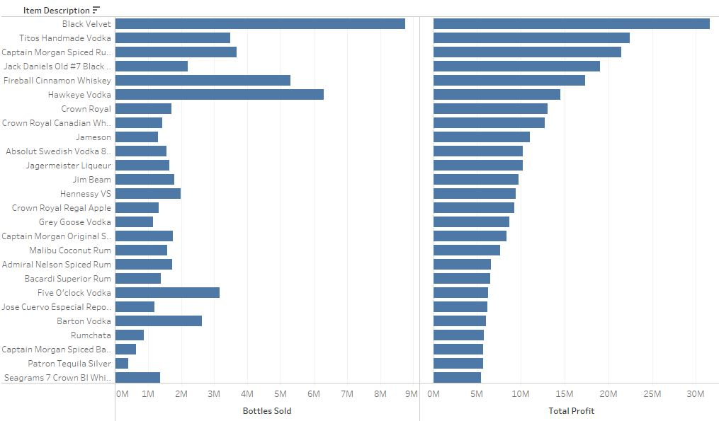
Bottles By Profit
A similar phenomenon as categories by profit is happening with bottles. Although Black Velvet has sold the most bottles Titos Handmade Vodka and Captain Morgan Spiced Rum perform much better when it comes to profit per bottle.

Slide 10
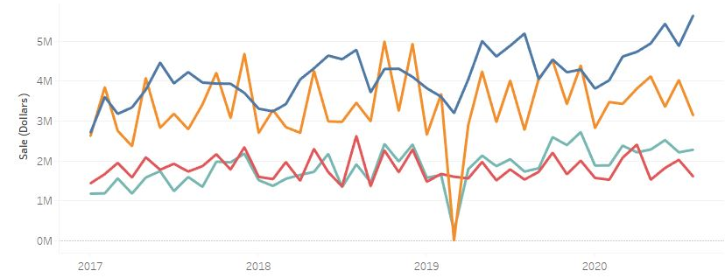
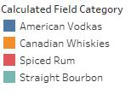
Growth of Categories
Of the top 4 categories only on has is seeing consistent growth and that is American Vodkas. The other categories are seeing minuscule growth or stagnation of sales.

Slide 11
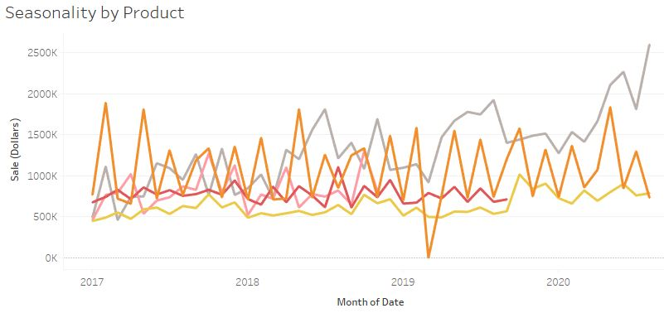
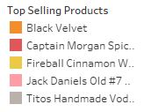
Growth of Individual Products
The growth in categories is reflected in the growth of individual products as well. As American Vodkas has grown so has Titos Handmade Vodka.

Slide 12
Project Findings
The purpose of this project was to make a business case for a liquor store in Iowa. I went through several key pieces of information that any potential business owner or entrepreneur would need to know.
The location that makes the most sense is the city of Davenport. It has high sales with less saturation of competition.
The key vendor relationships are with Diageo Americas and Fifth Generation. These suppliers sell four of the top five selling products and have the product with the most growth.
Both product and Category growth are trending up with American Vodkas and staying stagnant with other top selling products and categories.
The product with the most growth was Titos Handmade Vodka and other varieties of Vodkas. However, shelves should also be stocked with products such as Black Velvet and assortments of whiskies to bring in more customers.

